Slide 1



Slide 2
Welcome to Travel Tide Insights Analysis
Prepared by Sarmad Khader

Slide 3
TABLE OF CONTENTS
01
02
03
04
05
06
Perks Analysis
User Engagement Analysis
Perks by Gender Analysis
Analysis of Marital and Parental Status
Age Group Analysis
Conclusion

Slide 4

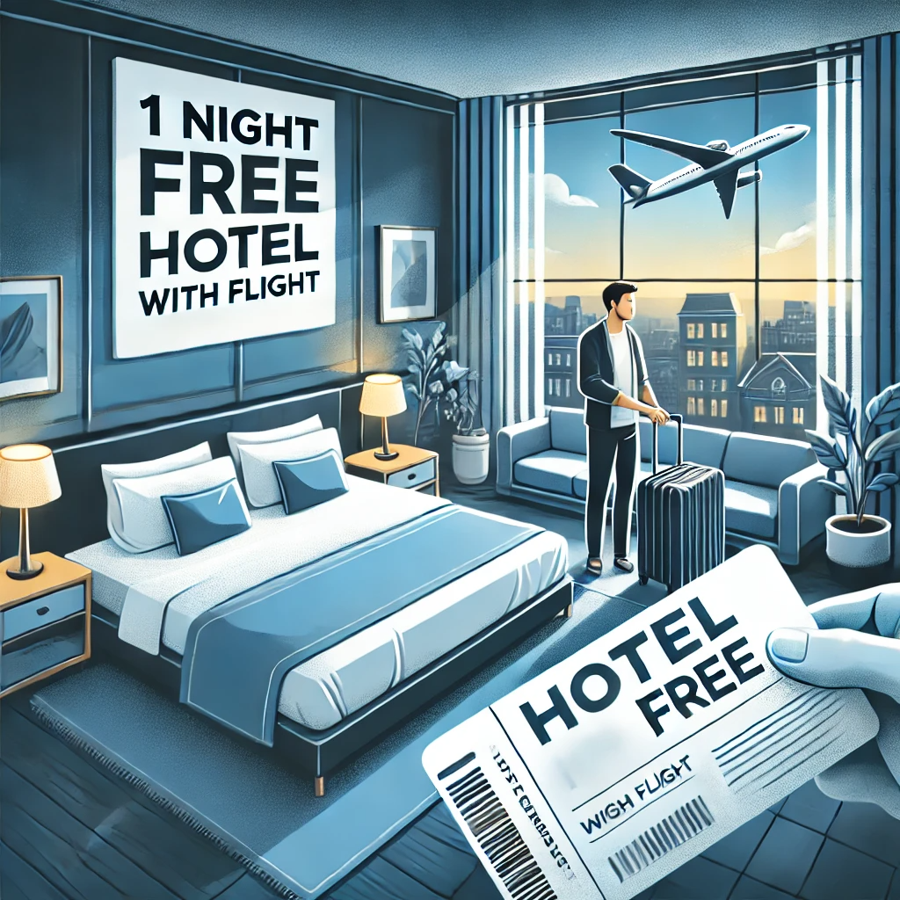




User Engagement and Perks Analysis
5,998 users were extracted from the TravelTide database and segmented into five perk segments.

Slide 5
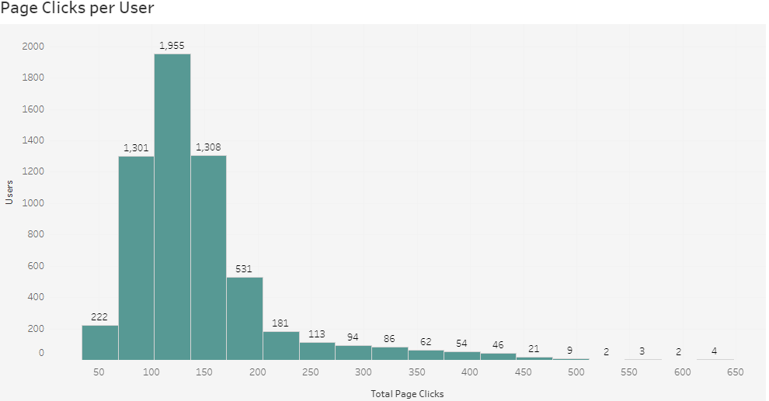
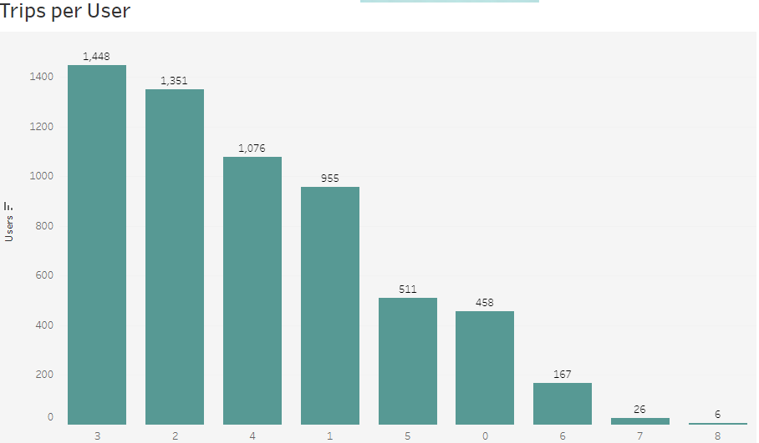
User Engagement and Perks Analysis
Finding: Users really value perks that offer direct savings and flexibility. The most loved perks include free checked bags, no cancellation fees, and 1 night free hotel stays with flights.
Recommendation: To make our users even happier, we should tailor perks based on user demographics. For example, families would greatly appreciate free checked bags, which can make their travel more convenient and cost-effective.

Slide 6
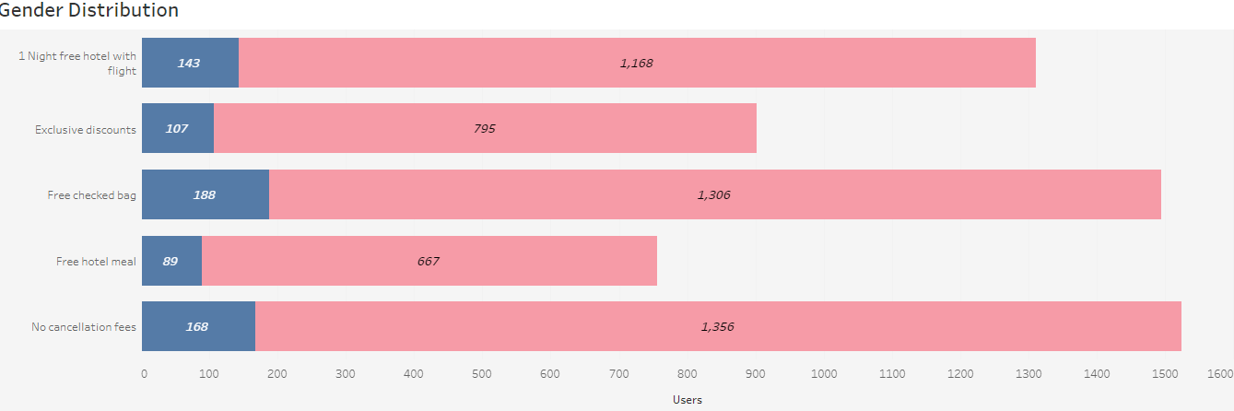
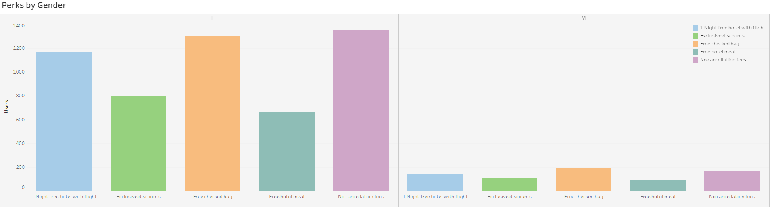
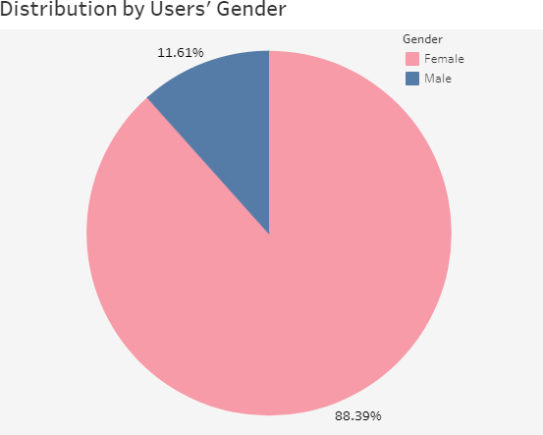
Perks by Gender Analysis
Finding: These gender-based preferences highlight the importance of tailoring our offerings.
Recommendation: We should develop targeted marketing campaigns that address these specific preferences. This approach will help increase engagement and satisfaction among our users.

Slide 7
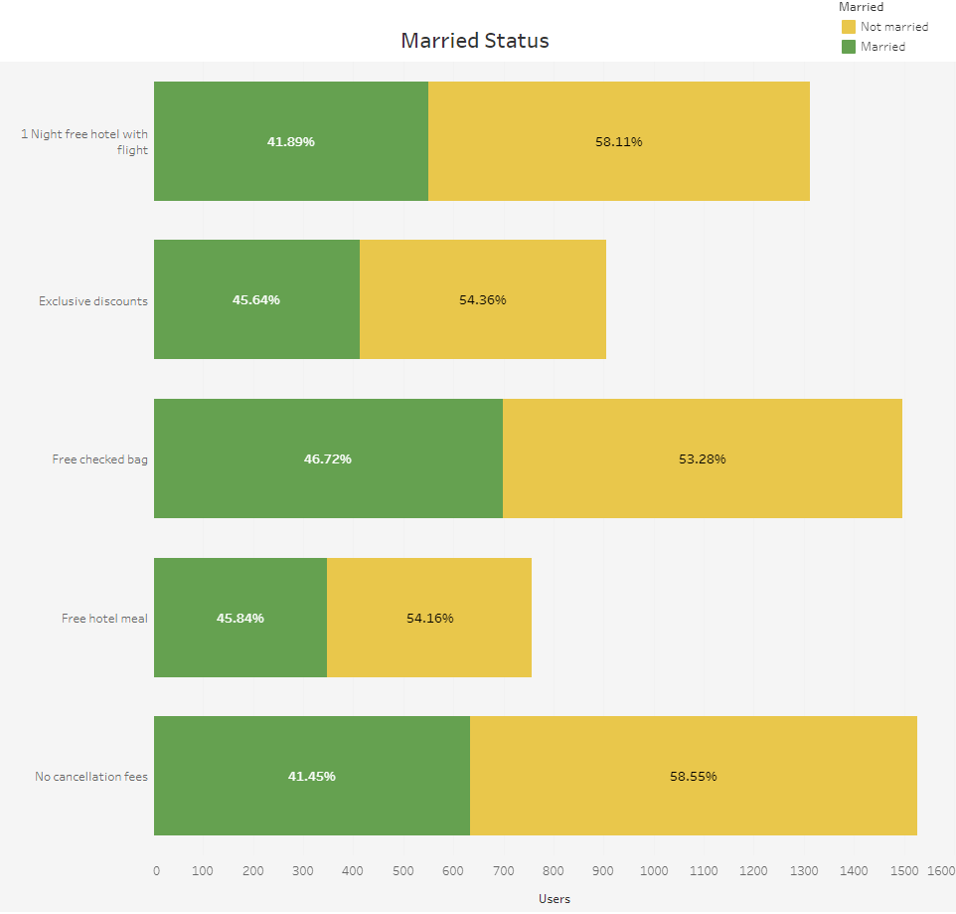
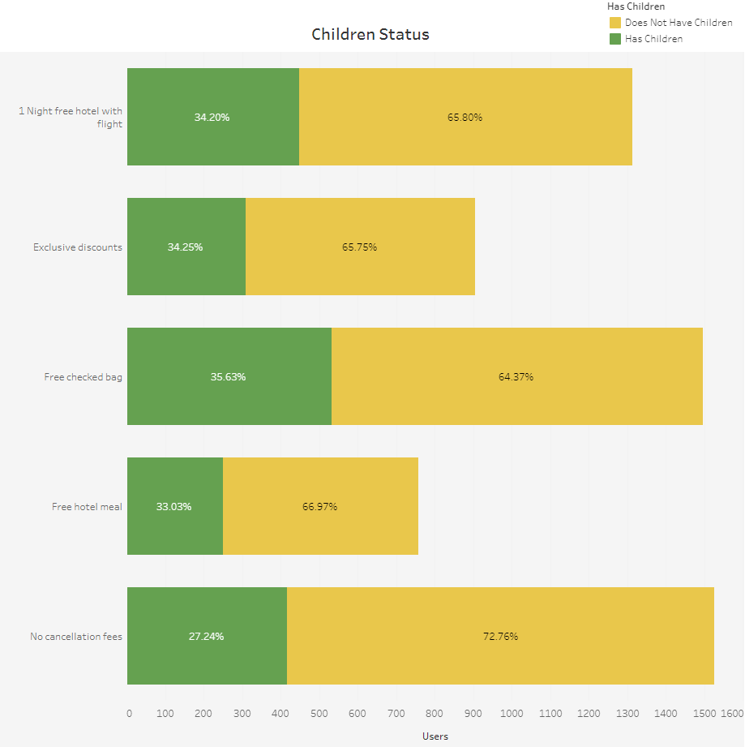
Analysis of Marital and Parental Status
Finding: Family-oriented users need perks that reduce travel stress and costs.
Recommendation: To cater to this segment, we should implement a tiered rewards program with family-friendly perks. This will encourage loyalty and repeat bookings among families.

Slide 8
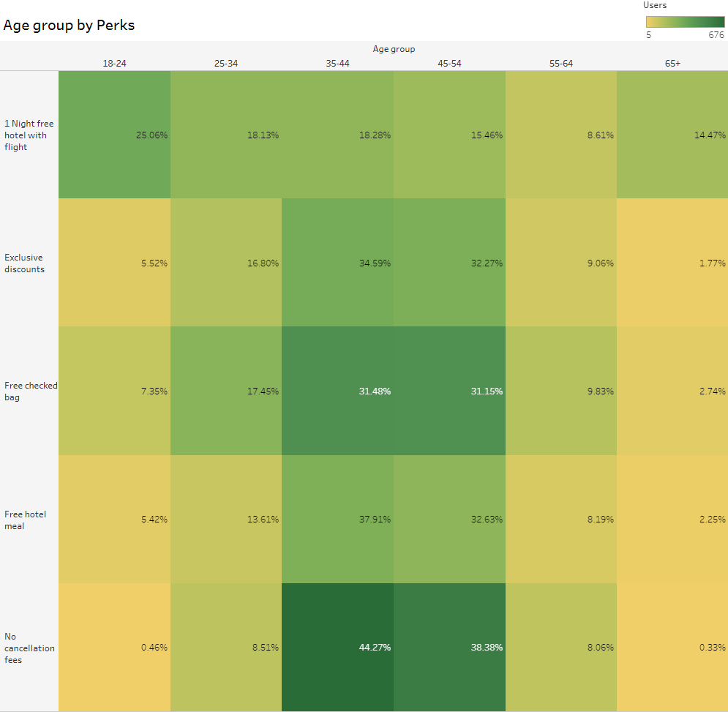
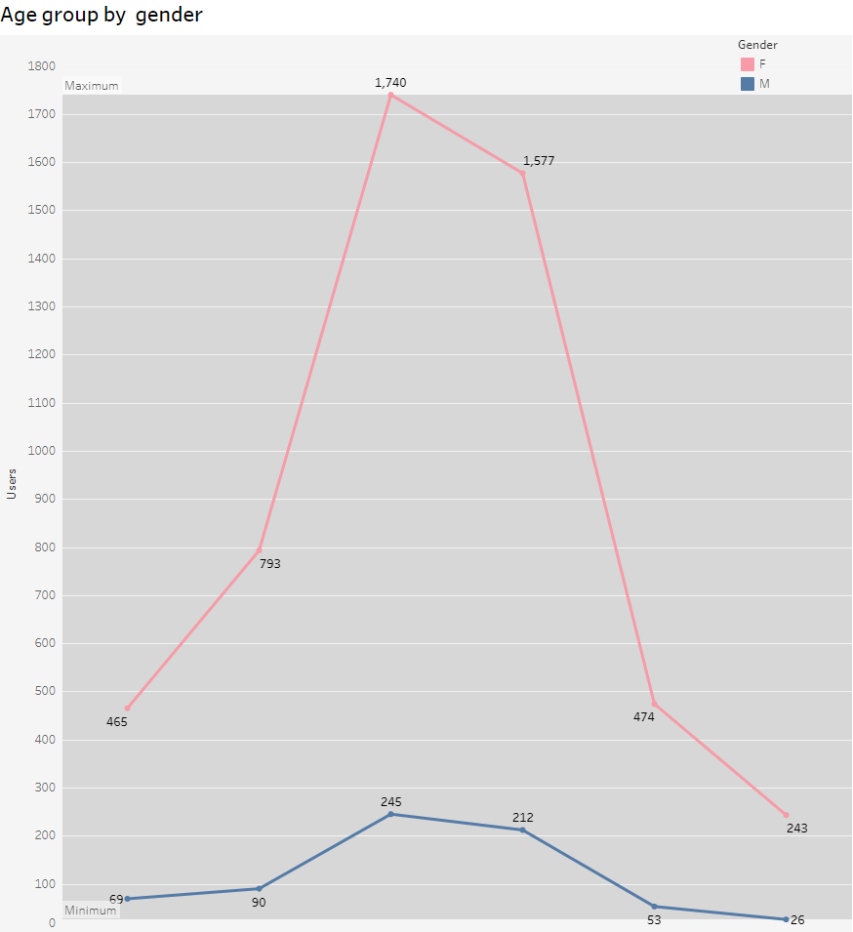
Age Group Analysis
Finding: Different age groups have distinct preferences that we need to address.
Recommendation: By creating targeted marketing campaigns for each age group, we can better meet their needs and enhance their satisfaction and retention.

Slide 9
Conclusion
Finding: Personalized perks and improved user experience are key to user satisfaction.
Recommendation: We should continuously refine perks based on user feedback and enhance site usability to keep our users engaged and satisfied.

Slide 10
Thank You!
Prepared by Sarmad Khader

